Slide 1
UNIT 3 (Cont.)
E. LANGUAGE FOCUS

Slide 2
CONTENTS
1
Pronunciation
2
Grammar
/l/ - /r/ - /h/
- Infinitive and gerund
- Passive infinitive and gerund

Slide 3
1. PRONUNCIATION:
/l/ - /r/ - /h/
Âm /h/ câm:
- “h” không được phát âm khi đi sau “w,g,c,r”.
Ví dụ:
What /wɒt/ Choir /kwaɪər/
Where /weər/ Ghastly /ˈɡɑːst.li/
When /wen/ Chorus /’kɔ:rəs/
Echo /ˈek.əʊ/ Rhythm /ˈrɪð.əm/
- “h” không được phát âm khi là chữ bắt đầu một số từ:
Hour /aʊər/
Honour /ˈɒn.ər/
Honest /ˈɒn.ɪst/
Heir /eər/

Slide 4
Âm /l/ câm
- “l” không được phát âm khi đứng sau “a,o,u” và trước các âm “d,f,m,k”.
Calm /kɑːm/ Palm /pɑːm/
Walk /wɔːk/ Stalk /stɔːk/
Half /hɑːf/ Would /wʊd/
Could /kʊd/ Salmon /‘sæmən/
*Ngoại lệ:
Halo /ˈheɪləʊ/ Bulk /bʌlk/
Sulk /sʌlk/ Hold /həʊld/
Sold /səʊld/

Slide 6
1. Hello, Mr. Allen. You’re early for lunch. It’s only eleven o’clock.

Slide 7
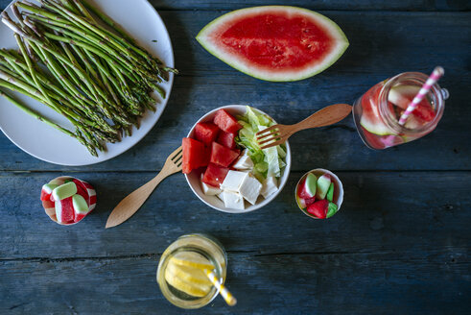
2. I’d like a plate of salad, a glass of lemonade, a slice of melon and some jelly, please.

Slide 8
3. Laura is a really pretty librarian in the public library.

Slide 9
4. Her parents own a restaurant in a country in central Europe.

Slide 10
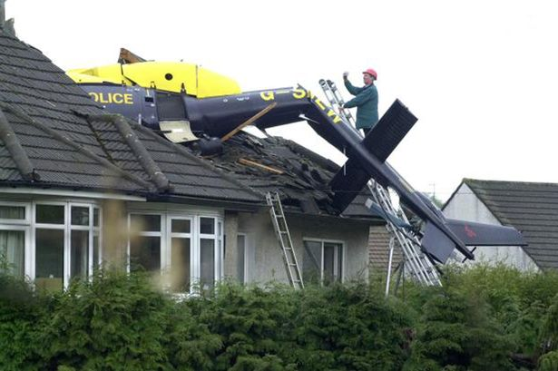
5. Hello, Harry. Have you heard the news? There’s been a horrible accident. A helicopter has hit Helen’s house.

Slide 11
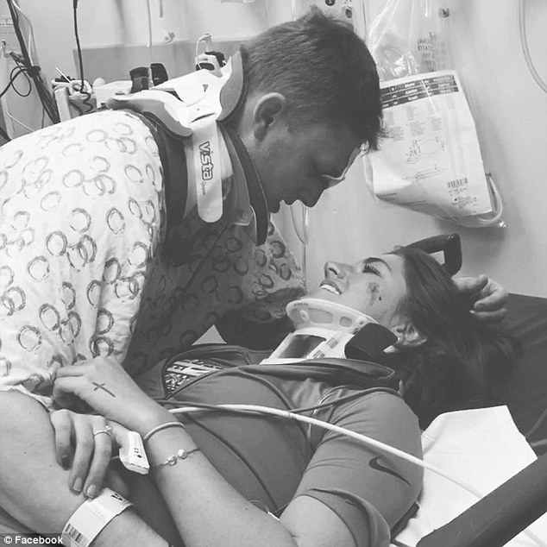
6. Helen and her husband will have to spend their holiday in hospital.

Slide 12
2. GRAMMAR
A. TO INFINITIVES:
Some verbs followed by to-infinitive
- afford: đủ khả năng - agree: đồng ý - appear: hình như - arrange: sắp xếp - ask: yêu cầu - attempt: cố gắng, nỗ lực - decide: quyết định - expect: mong đợi - fail: thất bại, hỏng | - hope: hy vọng - intend: định - invite: mời - learn: học - manage: xoay sở - offer: cho, tặng, đề nghị - plan: lên kế họach - pretend: giả vờ - promise: hứa | - refuse: từ chối - seem: dường như - tell: bảo - tend: có khuynh hướng - threaten: đe dọa - want: muốn - would like: muốn, thích

Slide 13
In some structures:
It takes / took / will take + O + time + to-inf
E.g. It takes Nam two hours to do that exercise.
to V so as (not) to V in order (not) to V
to send a letter.
E.g. I went to the post office so as to send a letter.
in order to send a letter.
{

Slide 14
S + V + Noun / pronoun + to-inf
E.g. I have some letters to write.
Is there anything to eat?
S + V + too + adj / adv + to-inf
E.g. He is too short to play basketball.
S + V + adj / adv + enough + to-inf
E.g. He isn’t tall enough to play basketball.
After what, who, which, when, where, how,… (not why)
E.g. I don’t know what to say.

Slide 15
B. GERUNDS:
Some verbs followed by V-ing
- admit: thừa nhận - avoid: tránh - appreciate: cảm kích - consider: xem xét - delay: hoãn - deny: phủ nhận - detest: ghét - encourage: khích lệ - fancy: thích - finish: kết thúc - hate: ghét | - imagine: tưởng tượng - involve: liên quan - mention: đề cập đến - mind: ngại - miss: bỏ lỡ - postpone: hoãn - practice: luyện tập - quit: từ bỏ - risk: có nguy cơ - suggest: đề nghị

Slide 16
- It is no use/It is no good: thật vô ích khi... - waste/spend: lãng phí, bỏ ra (thời gian, tiền bạc) - have difficulty/trouble: gặp khó khăn/trở ngại - can’t help=can’t stop=can’t resist: không thể không - can’t stand=can’t bear: không chịu đựng nổi - feel like: muốn - look forward to: mong đợi - What about/How about...? | - keep / keep on: tiếp tục - be busy: bận rộn - be worth: đáng - be used to/be accustomed to: quen với - get used to: trở nên quen với việc gì - be committed to: cam kết, hứa làm gì - be opposed to: phản đối - be resigned to : cam chịu - in addition to: ngoài ... ra - object to: phản đối
E.g. They couldn’t help laughing when they heard the little boy singing a love song.
The students are used to working in the school library.
Please wait a minute. My boss is busy writing something.

Slide 17
Sau các liên từ: after, before, when, while, since,… + V-ing
E.g. After finishing his homework, he went to bed.
Sau các giới từ: on, in, at, of, about, for, to, up, out, …… + V-ing
E.g. My sister is interested in listening to music.

Slide 18
C. GERUNDS AND TO-INFINITIVE:
*Không thay đổi nghĩa:
begin, start, continue, like, love, hate
+ To-inf / V-ing
E.g. It started to rain / raining.
But : It was beginning to rain.

Slide 19
*Thay đổi nghĩa:
REMEMBER / FORGET
remember / forget + to-inf
+ Nhớ / quên việc cần làm, việc chưa xảy ra:
E.g. I remember to send the letter.
Don’t forget to turn off the light when you go to bed.
+ Nhớ / quên / nuối tiếc việc đã xảy ra rồi (trong quá khứ) :
E.g. I remember sending the letter.
I remember meeting you somewhere but I can’t say your name.
remember / forget + V-ing

Slide 20
REGRET
regret + to-inf: Tiếc phải báo tin xấu
E.g. I regret to tell you that we are unable to help you.
regret + V-ing: Tiếc nuối việc đã xảy ra trong quá khứ
E.g. I regret leaving school at 14.

Slide 21
STOP
stop + V-ing : Dừng hẳn việc gì
E.g. He stopped smoking because it is harmful to his health.
E.g. On the way home, I stopped at the post office to buy a newspaper.
stop + to-inf : Dừng ….. để …

Slide 22
TRY
try + V-ing : thử
E.g. The room is hot. I try opening the window.
try + to-inf : cố gắng
E.g. I'm trying to learn English.

Slide 23
NEED
need + V-ing = need + to be + V3 : cần được (bị động)
E.g. The windows need painting = The windows need to be painted.
need + to-inf: cần (chủ động)
E.g. I need to wash my car

Slide 24
GO ON
go on + V-ing: tiếp tục việc đang làm
E.g. I can’t go on pretending that everything is still OK.
go on + to-inf: đổi việc này sang việc khác
E.g. After discussing the economy, the minister went on to talk about the education

Slide 25
MEAN
mean + V-ing: có nghĩa là
E.g. This new order will mean working overtime.
mean + to-inf: muốn, có ý định
E.g. I didn’t mean to hurt you.

Slide 26
Exercise 1. Complete the sentences with the correct form, gerund or infinitive, using the words in brackets.
1. Most passengers dislike ________to sit in small uncomfortable seats on long flights. (have)
2. I must drive more carefully. I can't risk ________ another speeding ticket. (get)
3. Did Dick mean __________ Sue about the party, or did it slip out accidentally? (tell)
4. You must keep ___________ on the computer until you understand how to use all of the programs. (practise)
5. The judge demanded ________ the original document, not the photocopy. (see)
having
getting
to tell
practising
to see

Slide 27
 | I want to be given a lot of gifts on my birthday. The children want to be helped with food, clothes and housing.
 | I hate being waken up on Sunday morning. Newspapers should be honest because readers like being told the truth.
Passive infinitive
to be + past participle
to be + V3/ed
Passive gerund
being + past participle
being + V3/ed

Slide 28
Exercise 2. Choose the correct answer to complete the sentences
Mrs. Thompson is always willing to help, but she doesn’t want…….at home unless there is an emergency.
A. to call B. to be called
2. The children agreed…..the candy equally.
A. to divide B. to be divided
3. I expected…..to the party, but I wasn’t.
A. to invite B. to be invited
4. I expect……at the airport by my uncle.
A. to meet B. to be met
5. Mr. Steinberg offered……….us to the train station.
A. to drive B. to be driven

Slide 29
Exercise 3. Choose the correct answer to complete the sentences
1. The new students hope………in many of the school’s social activities.
A. Including B. being included C. to include D. to be included
2. Jack got into trouble when he refused…………his briefcase for the customs officer.
A. opening B. being opened C. to open D. to be opened
3. Barbara didn’t mention………about her progress report at work, but I’m sure he is.
A. concerning B. being concerned C. to concern D. to be concerned
4. You’d better save some money for a rainy day. You can’t count on…………by your parents every time you get into financial difficulties.
A. Rescuing B. being rescued C. to rescue D. to be rescued
5. Please forgive me. I didn’t mean…………you.
upsetting B. being upset C. to upset D. to be upset

Slide 30
FURTHER PRACTICE
I. Put the verbs in parentheses in the correct form (PASSIVE INFINITIVE or GERUND): 1. That man seems (trust)_____________________ by everyone. 2. Mr. Forster hopes (transfer) _____________________ to New York by his company. 3. No one enjoys (deceive) _____________________ by another person. 4. I absolutely refused (cheat) _____________________ by them in that manner. 5. We appreciate (inform) _____________________ about the matter promptly= quickly. 6. Naturally, I would like (promote) _____________________to higher position. 7. That author doesn’t mind (criticize) _____________________ by his friends. 8. The whole problem certainly needs (consider) _____________________ very carefully. 9. That fellow couldn’t avoid (choose) _____________________ into military service. 10. I really didn’t expect (introduce) _____________________ to the president.
to be trusted
to be transferred
being deceived
to be cheated
being informed
to be promoted
being criticized
to be considered
being chosen
to be introduced

Slide 31
FURTHER PRACTICE
II. Rewrite each sentences using passive gerund or passive infinitive.
1. I don’t like people shouting at me.
................................................................................................................................................
2. I hate people staring at me.
................................................................................................................................................
3. We need to redecorate the living room.
................................................................................................................................................
4. Someone may recognize her. She is wearing glasses to avoid that.
She is wearing........................................................................................................................
5. People criticize him, but he doesn’t mind that.
................................................................................................................................................
6. People ask her about her past, she hates that.
................................................................................................................................................
I don’t like being shouted at.
I hate being stared at.
The living room needs to be redecorated.
glasses to avoid being recognized.
He doesn’t mind being criticized.
She hates being asked about her past.

Slide 32
THANK YOU

